Slide 1
@ONWiE_
@ONWiE.ca
@ONWiE_
The Ontario Network of Women in Engineering
& McMaster Engineering
Outreach and Inclusion
Dr. Kim Jones
Chair, ONWiE
Associate Professor, Chemical Engineering
McMaster University

Slide 2
Ontario Network of Women in Engineering (ONWiE)
Vision: To increase the diversity in the engineering profession by working together
Formed in 2005 as a unique collaboration between all 16 engineering and applied science schools in Ontario; now nation-wide
@ONWiE_
@ONWiE.ca
@ONWiE_

Slide 3
Ontario Network of Women in Engineering (ONWiE)
Signature programming includes Go ENG Girl, Go CODE Girl and Girl Guide Badge Days
Hands-on workshops are geared to girls in grades 7 – 10; parents are included
Programming is fully supported through sponsorship
@ONWiE_
@ONWiE.ca
@ONWiE_
Notes:
Suggested bullet page for your presentation.

Slide 4
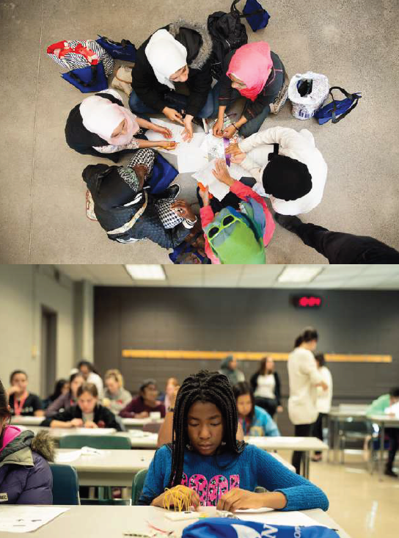
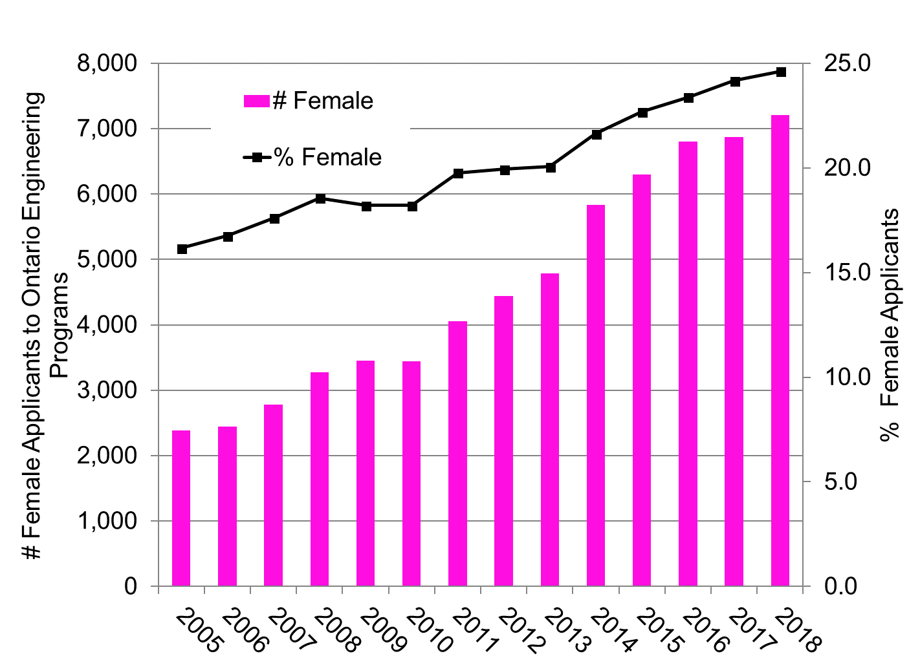
Facts:
All 16 Ontario Engineering schools and 13 additional schools outside of Ontario participate each year
Approximately 25,000 girls have participated in our programming since 2005
More than 300 volunteers and nearly 2000 parents participate each year
@ONWiE_
@ONWiE.ca
@ONWiE_
Notes:
This open PowerPoint template page is completely customizable

Slide 5
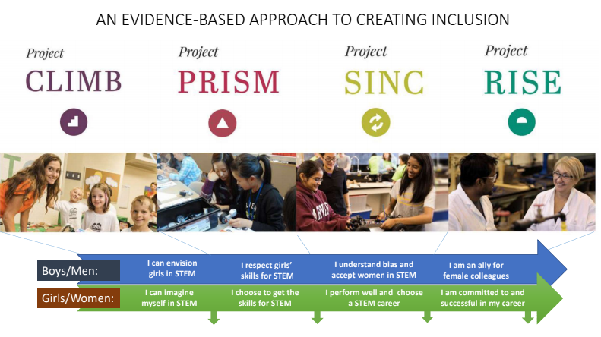
Research: Engendering Success in STEM
@ONWiE_
@ONWiE.ca
@ONWiE_
Notes:
1 minute

Slide 6
Small encouragements can make big changes
SFU – doubled computer engineering (Leslie Shannon)
Highlight how comp. sci. can combine with ANYTHING
Emphasize “Everyone can do this”
Remind students of women’s historical contributions
Need examples linking community values to electrical, computer, mechanical!
@ONWiE_
@ONWiE.ca
@ONWiE_

Slide 7
Early interventions matter
Warm climate statements (also in job ads): Mesmin Destin
Panels for first year students with questions emphasizing background
Parent panels help
Near-peer identity-based mentoring
@ONWiE_
@ONWiE.ca
@ONWiE_

Slide 8
@ONWiE_
@ONWiE.ca
@ONWiE_

Slide 9
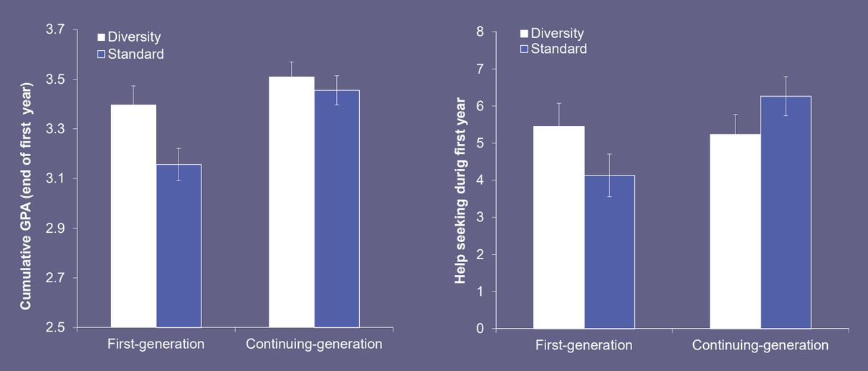
@ONWiE_
@ONWiE.ca
@ONWiE_

Slide 10
Authenticity, safety, fit are important
Undervaluing social aspects of engineering practice affects women (Jackie Koyama)
Unexpected social barriers in the workplace are shocking
Retention (due to fit -> commitment issues) goes down
Promoting positive interactions/respect (from men to women) reduces social identity threat (Emily Cyr)
@ONWiE_
@ONWiE.ca
@ONWiE_

Slide 11
@ONWiE_
@ONWiE.ca
@ONWiE_

Slide 12
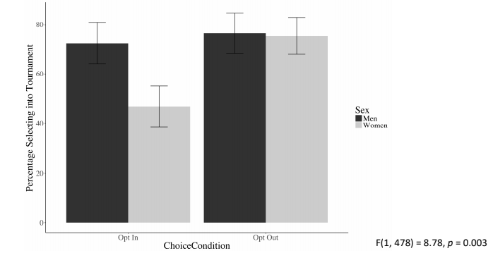
Leadership and choice are gendered
Men are led in a more autocratic, dominant style (Holly Engstrom)
Q: Are leaders sharing explicit expectations with women?
Opt-out approach evens the gender playing field – self-nomination is not balanced (Joyce He)
Create pool of leadership
candidates
Create pool of potential
award nominees
@ONWiE_
@ONWiE.ca
@ONWiE_

Slide 13
Allyship matters
Allyship reduces social identity threat (Tara Dennehy)
Amplification: “Kim had a great point earlier. Kim – could you elaborate on it?”
Inclusion training works (Hilary Bergsieker)
Allyship is inhibited if there is a perception that others are biased (Lucy De Souza)
Biased actions disproportionately affect minority groups (Aday, Dennehy, Chavula)
Ally actions help; proactive ones help more
@ONWiE_
@ONWiE.ca
@ONWiE_

Slide 14
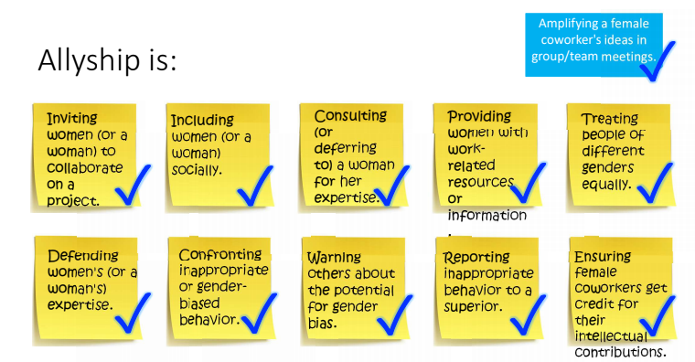
@ONWiE_
@ONWiE.ca
@ONWiE_

Slide 15
Themes
Wide range of potential
Values are important (communal)
Social skills (networking, teamwork etc.) – highlight in undergrad
Fit and positive interactions are critical
Leadership / advancement is gendered
Allyship matters; prompts work
@ONWiE_
@ONWiE.ca
@ONWiE_

Slide 16
Actions
Panels in Welcome/Frosh Week
Underrepresented students (first gen, women, foreign, BIPOC etc.)
Ask questions like:
How did your previous experiences (e.g. as an underrep. woman) prepare you to…
What advice do you have for people of similar backgrounds?
Market to highlight breadth of opportunity, fit with communal values
Highlight mech / elec / comp breadth of possibilities / helping
Explicitly discuss values / fit / teamwork / allyship
@ONWiE_
@ONWiE.ca
@ONWiE_

Slide 17
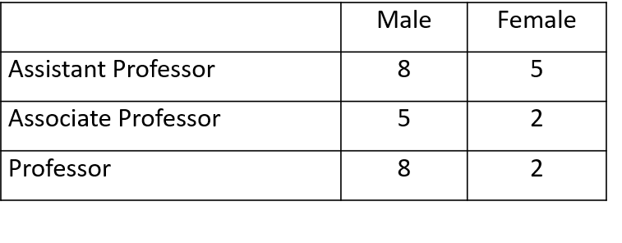
SWE Conference: Coffee with a Colleague
Issue: Networking outside home department can be tricky – particularly for women
Interested faculty members submit names
Monthly random matches
Faculty members arrange meeting times
Nov 2018-May 2019
@ONWiE_
@ONWiE.ca
@ONWiE_

Slide 18
SWE Conference: Initiating Inclusion Discussion
Issue: It can be difficult to incorporate regular discussions outside official training
Tools:
SWE Knowledge Cards
NSERC Chairs White Papers
http://www.sfu.ca/wwest/resources/White-Papers.html
ESS White Papers
http://successinstem.ca/resource-category/whitepaper/
DiversifySTEM.ca
How to use:
Basis for training or personal reflection
One shared at the start of each meeting to initiate brainstorming: Relevance to us? Possible actions?
Pair and share
@ONWiE_
@ONWiE.ca
@ONWiE_

Slide 19
Interesting resources
Playbook for retaining women in tech: https://movethedial.com/resources
Teacher resources: https://womeninstem.ingeniumcanada.org/resources/
Tools for reducing bias at work: https://biasinterrupters.org/
Teamwork: https://rework.withgoogle.com/print/guides/5721312655835136/
Catalyst: https://www.catalyst.org/
AI hiring bias simulator: https://www.survivalofthebestfit.com/
Purl Inclusion video: https://www.youtube.com/watch?v=B6uuIHpFkuo
Inclusion starts with an I: https://www.youtube.com/watch?v=2g88Ju6nkcg
Accessible design: https://mismatch.design/category/resources/

Slide 20
Inclusive Teamwork in McMaster Engineering
Focus groups have revealed several identity-related issues with teamwork
Women are often segregated to non-technical roles
“Only” members of teams are excluded or isolated
Student-formed teams are culturally and gender segregated
Teamwork is neither taught nor assessed; learning is purely experiential
No safe/established mechanisms to resolve team conflict
Team meetings can be difficult to schedule

Slide 21
PIVOT: Experiential learning
McMaster Engineering first year is moving to project-based learning
Four “traditional” courses merged into a year-long course with four “sprint” projects
Project-based learning motivates all students, but particularly under-represented groups
Group work can be similarly motivating, but needs to be designed intentionally

Slide 22
Our team-work plans
No teams with only one woman
Roles explicitly described and rotate between projects
Mid-project qualitative peer feedback; reflection
Technically-focused icebreaker tasks
Inclusive teamwork discussed in lecture
One TA will be designated to address team conflict
Time in design studios for team discussions

Slide 23
Thank you!
Questions?

